Slide 1

Welcome to My Presentation

Slide 2
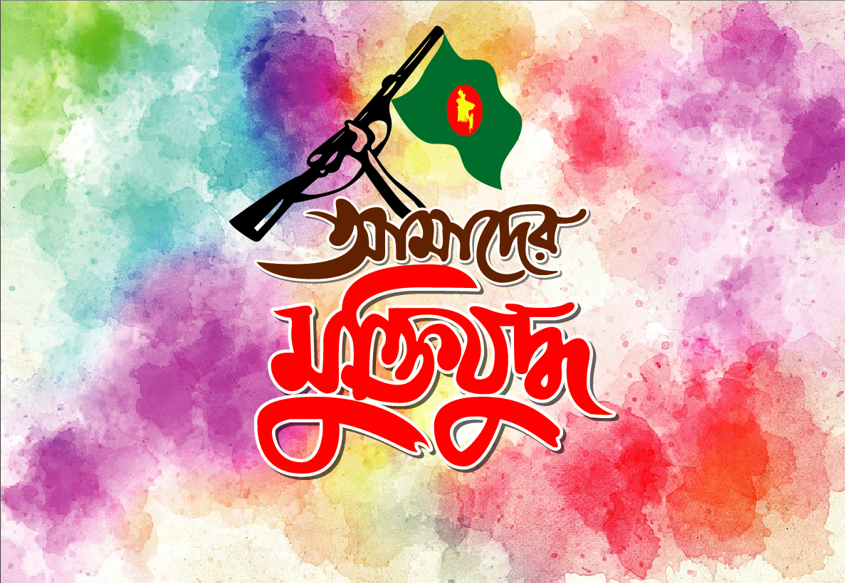
The Liberation War of Bangladesh, 1971
"A Historic Struggle for Independence"

Slide 3
Background
Colonial Legacy: Partition of British India in 1947; creation of East and West Pakistan.
Economic and Political Disparity: Marginalization of East Pakistan in politics and economy.
Language Movement of 1952: Resistance to Urdu imposition; the rise of Bengali nationalism.

Slide 4
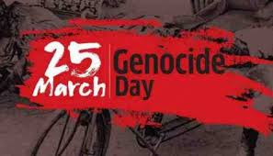
Prelude to War
Election of 1970: Sheikh Mujibur Rahman led the landslide victory of Awami League.
West Pakistan's Response: Refusal to hand over power; growing tensions.
Operation Searchlight (March 25, 1971): Crackdown on Dhaka; mass atrocities.

Slide 5
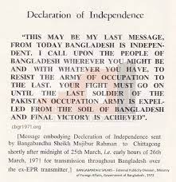
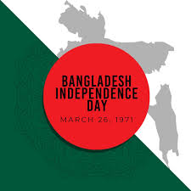
Key Events of the Liberation War
Declaration of Independence: March 26, 1971.
Formation of Mukti Bahini (Freedom Fighters): Guerrilla resistance against Pakistani forces.
Major Battles: Battle of Garibpur, Battle of Sylhet, and other significant engagements.

Slide 6
Humanitarian Crisis
Genocide and Atrocities: Targeting of intellectuals, minorities, and civilians.
Refugee Crisis: Over 10 million refugees fled to India.
Global Reaction: Mixed international response; role of media in highlighting the crisis.

Slide 7
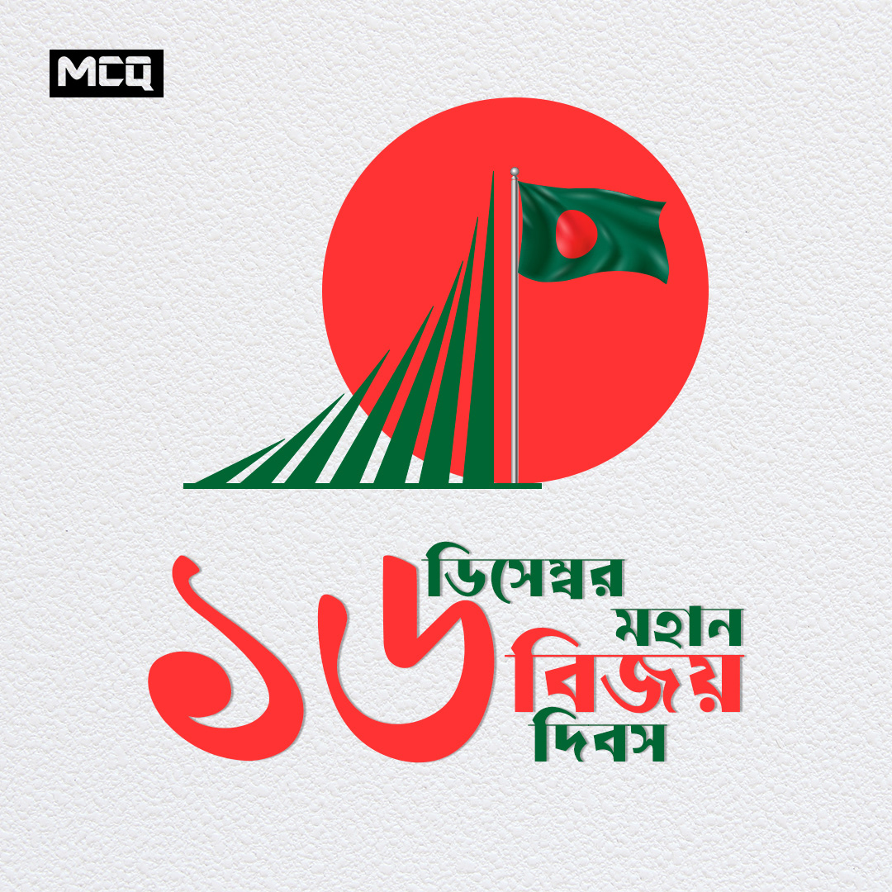
Outcome of the War
Independence of Bangladesh: December 16, 1971.
Casualties: Estimated 3 million killed; countless displaced.
Impact on South Asia: Geopolitical and humanitarian ramifications.

Slide 8
Legacy of the 1971 War
Creation of a Nation: Birth of Bangladesh as a sovereign state.
Ongoing Trials: Justice for war crimes; trials of collaborators.
Cultural Resurgence: Preservation of Bengali identity and pride.

Slide 9
Conclusion
Triumph of resilience and determination.
Importance of unity in the face of oppression.
Lessons for global peace and justice.

Slide 10
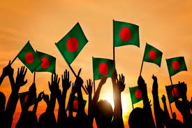
"The spirit of 1971 lives on in the hearts of Bangladeshis."

Slide 11

1971 War of Bangladesh

Slide 12
Thank You!

